Slide 1
Computer Vision
Lecture 1
Simon McLoughlin

Slide 2
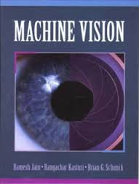
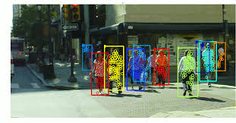
Computer and Machine Vision
Computer/Machine Vision is the science an technology of machines that see.
The technology is concerned with cameras, scanners, lighting, optics, computer hardware and software etc.
The science is concerned with the theory (largely mathematics, but other disciplines too) that obtains information from images (data), a form of pattern recognition.
In 1966 Marvin Minsky of MIT hired an undergraduate student over the summer and asked him to connect a TV camera to a computer and get it to describe what it sees. The level of difficulty of the problem soon became apparent.

Slide 3

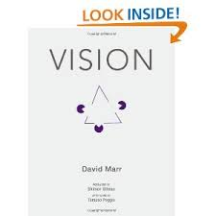
Computer Vision and Biological Vision
The ultimate goal of computer vision is to mimic the human visual system.
A lot of early work by people such as the neuroscientist David Marr in the 1970s looked at the human visual system from a computational perspective with a view to identifying the processes the visual system goes through to achieve recognition.
One of the first stages of vision he hypothesised was the primal sketch of a scene, based on feature extraction of fundamental components of the scene, including edges, regions, etc. This is a similar notion to a pencil sketch drawn quickly by an artist as an impression.
Artificial Neural Networks are based on their biological counterparts

Slide 4
My Background
Mainly in area of image processing/computer vision in ITS
Areas such as road sign detection/recognition, line detection and measurement, stereo vision
Also worked on some other vision problems (golf swing analysis, measuring strain in rubber etc.)

Slide 5
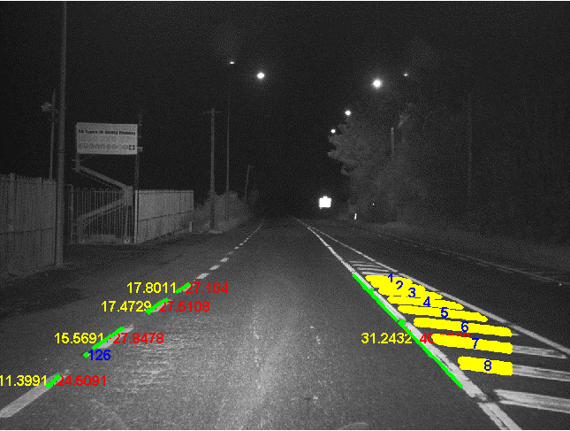
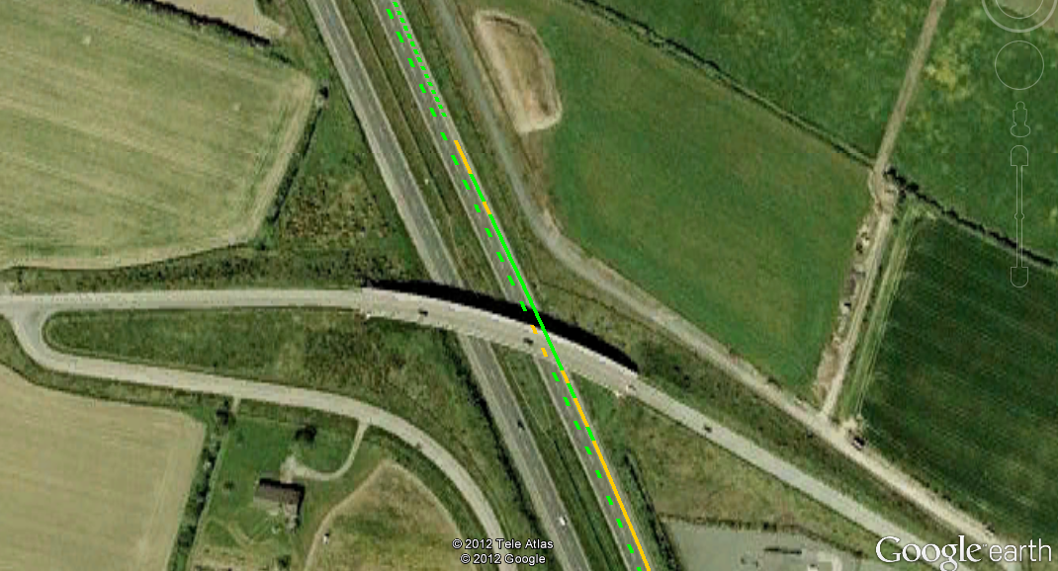
Road Line extraction and Measurement

Slide 6
The course! - Breakdown
50/50 Final Exam/CA
CA will be combination of small assignments, 1 big (but not too big) assignment and possibly paper review(s)
CA work will be done using OpenCV
Main topics (not necessarily in this order)
Image formation (lighting, optics, cameras etc)
Binary image analysis
Segmentation
Motion handling and Tracking
Using colour
3D Computer Vision (stereo)
Applications

Slide 7
The Books
In the Library
Machine Vision – Ramesh Jain (A classic)
A Practical Introduction to Computer Vision with OpenCV - Kenneth Dawson Howe (A new book from Lecturer in TCD, looks good but uses C++)
Digital Image Processing – Gonzalez
A few others worth a look, search under computer/machine vision, image processing etc
Others
Learning OpenCV – Bradski and Kaehler (C++). http://www.cse.iitk.ac.in/users/vision/dipakmj/papers/OReilly%20Learning%20OpenCV.pdf
Computer Vision – Shapiro. http://nana.lecturer.pens.ac.id/index_files/referensi/computer_vision/Computer%20Vision.pdf
OpenCV 3.0, OpenCV with Java. Daniel Lélis Baggio

Slide 8
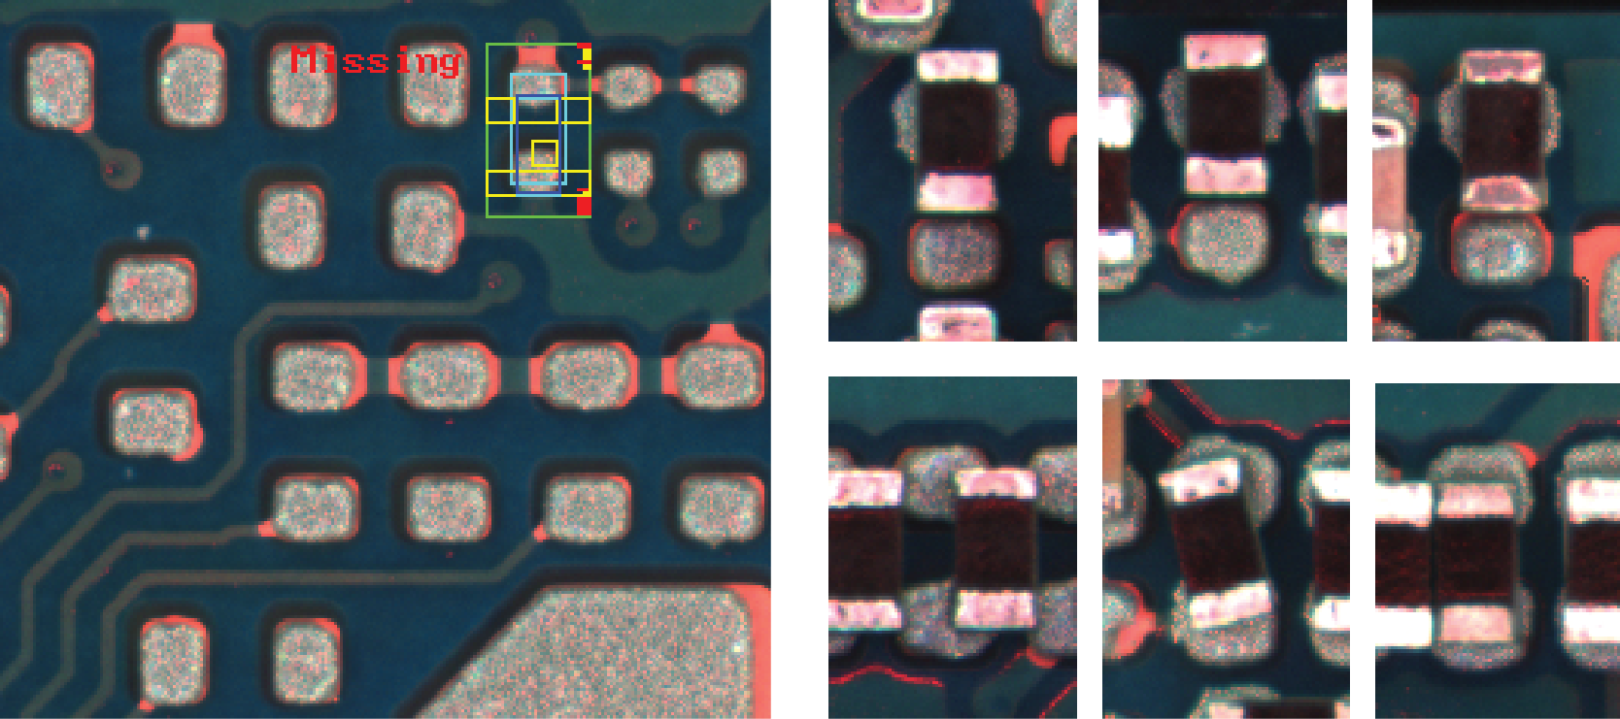
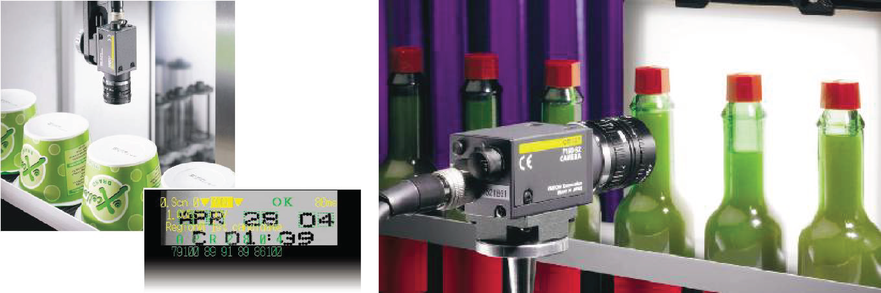
Computer Vision Applications!- A good place to start
Industrial Inspection!
© Reproduced by permission of James Mahon
© Reproduced by permission of Omron Electronics LLC

Slide 9
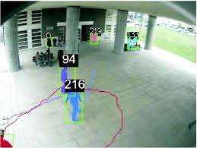
Computer Vision Applications!- A good place to start
Surveillance

Slide 10
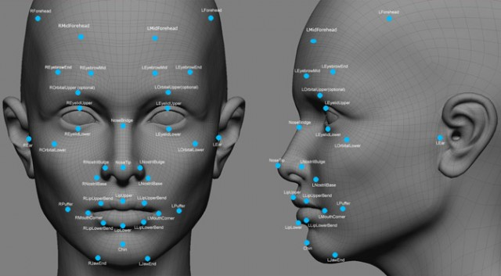
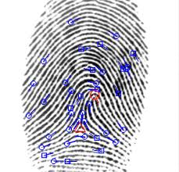
Computer Vision Applications!- A good place to start
Biometrics

Slide 11
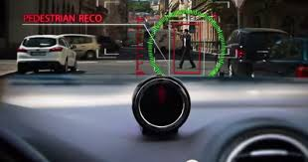
Computer Vision Applications!- A good place to start
Self Driving Cars

Slide 12
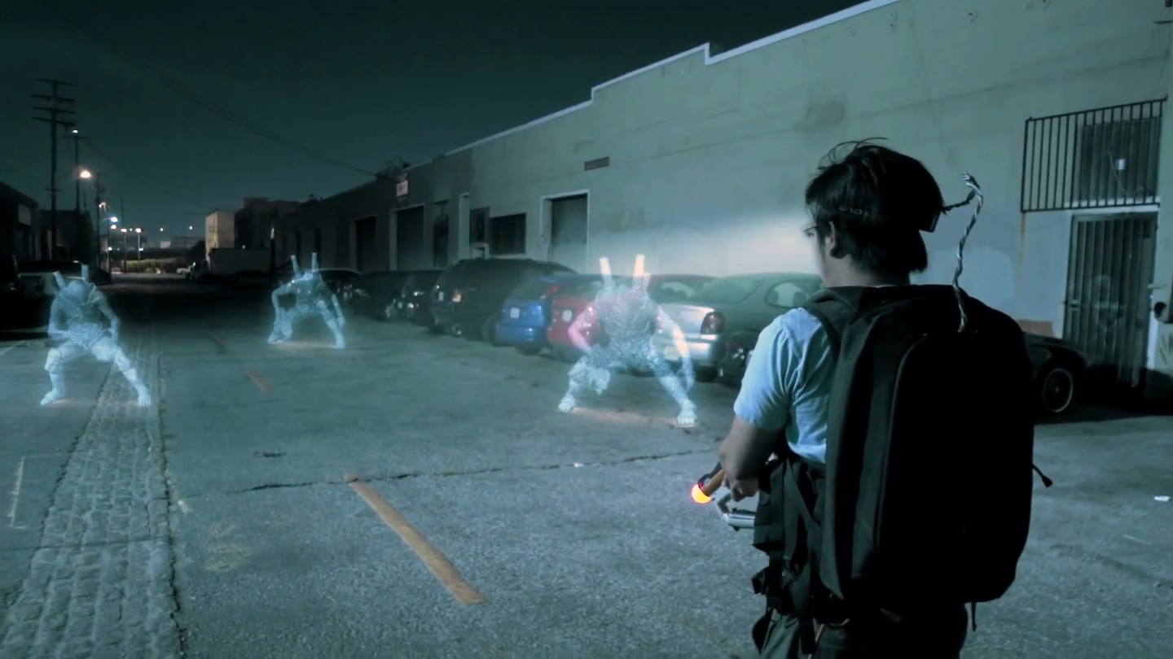
Computer Vision Applications!- A good place to start
Augmented Reality

Slide 13
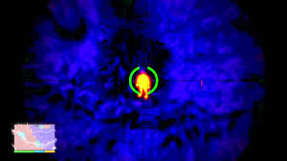
Computer Vision Applications!- A good place to start
UAVs and drones

Slide 14
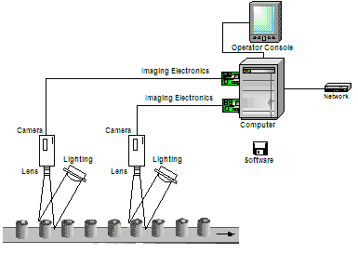
Machine Vision System
Main Components
Cameras
Optics (lens + filters)
Lighting
Software (image processing)
Robot arm? Pick and place

Slide 15
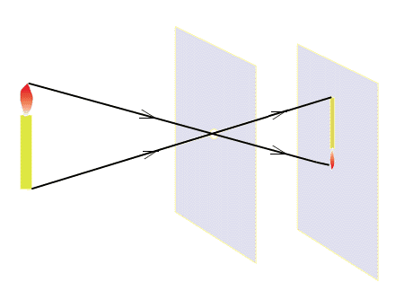
Image Formation
f
Pinhole Camera Model
(X_{i},Y_{i})
O
X_{i} = fX_{w}/Z_{w}
Y_{i} = fY_{w}/Z_{w}
(X_{w},Y_{w},Z_{w})

Slide 16
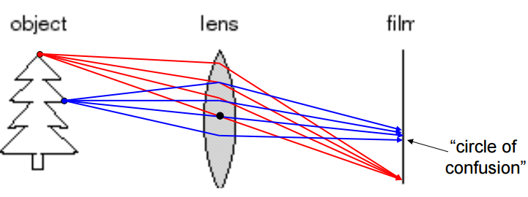
Adding a lens
A lens focuses light onto the film
There is a specific distance at which objects are “in focus” – other points project to a “circle of confusion” in the image •
Changing the shape of the lens changes this distance

Slide 17
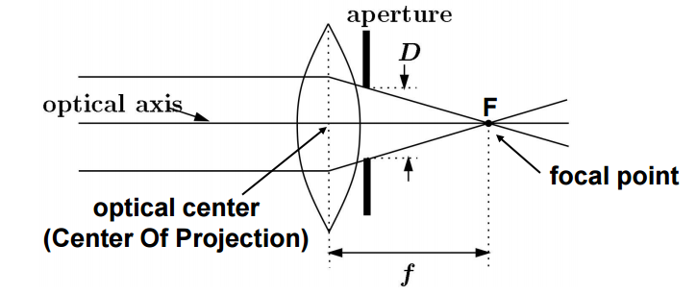
Focal Length, Aperture, Depth of Field
A lens focuses parallel rays onto a single focal point
The focal point is a distance f beyond the plane of the lens
Aperture of diameter D restricts the range of rays

Slide 18
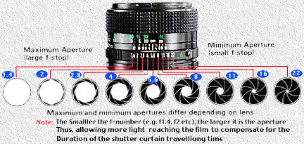
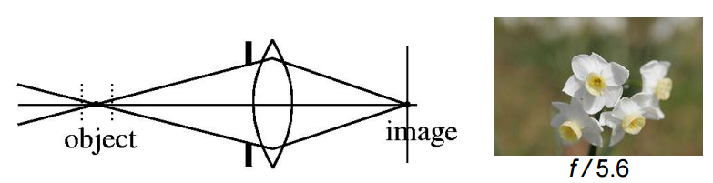
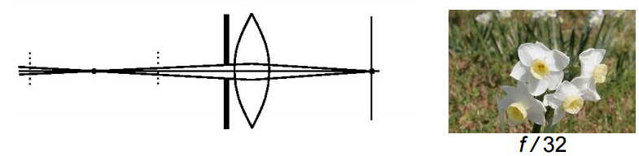
Depth of Field (DoF)
DoF – This is the area in object space that will be in focus in the image
Changing the aperture size or focal length affects depth of field

Slide 19
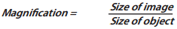
Lens Selection
The most basic feature of lens selection is the relationship between the size of the image and that of the object:
Magnification also depends on the working distance. The more distant the object the smaller the image. Thus, the use of the parameter magnification only makes sense if we know the working distance at the same time so we need to incorporate this into our lens formula - the resultant formula describes common lens parameter – the focal length

Slide 20
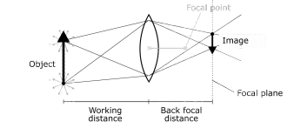
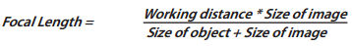
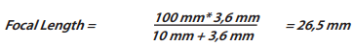
Focal Length
The focal length of the lens is the distance between the lens and the image sensor when the subject is in focus
Let us assume we would like to inspect the quality of bolts during the production process.
The diameter of each bolt is 10 mm and the working distance from the camera is 100 mm and the height of the image sensor is 3.6mm

Slide 21
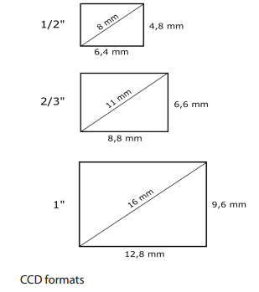
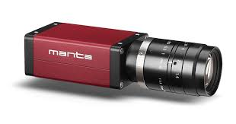
Camera Selection
There are a number of factors that will affect which camera should be used for an application:
Sensor size and pixel size (tradeoff between resolution and sensitivity/dynamic range)
Interface – USB 3.0, FireWire, GigE Vision, CameraLink etc
Smart Functionality and GPIO/Trigger
Dynamic range
Noise Levels (CCD vs CMOS, the debate goes on )
Frame Rate
API and software packages
Cost
Colour or monochrome

Slide 22
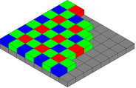
Camera Selection – Colour or Monochrome
A monochrome camera is just a greyscale camera. There is only one colour, grey! The brightest shade of which is white and the darkest is black.
These images are simpler process and there is only 1 channel so less data than colour images but colour images obviously can provide more discriminatory information encoded as different colour values.
Colour cameras use the same sensors as monochrome cameras but have a special filter over the sensor called a Bayer filter.
A Bayer filter mosaic is a colour filter array (CFA) for arranging RGB color filters on a square grid of photosensors.
To find the RGB values for a single cell on the sensor the surrounding colour values are interpolated to estimate the 3 components for each cell

Slide 23
Digital Images - Sampling
Digital video is simply an alternative means of carrying a video waveform
The analog signal is measured at regular intervals called “samples”
If enough of these samples are taken the video signal can be unambiguously reconstructed from the samples
The frequency at which samples are taken is called the sampling rate
A lower bound on the sampling rate was shown by Nyquist-Shannon to be twice the highest frequency in the analog signal – TV?
samples

Slide 24
Digital Images - Quantisation
After sampling the analog signal we have a set of numbers or digits (the samples) which constitute the video – hence the name digital video
Although the signal is now represented by a set of samples, we must define upper and lower bounds on the samples and only allow a sample to represent a finite number between these upper and lower bounds
This process is known as “quantization”
When quantizing an image, we do not change the number of samples but do limit the range of values a sample can take on therefore the lower the level of quantization the lower the amount of memory/channel bandwidth we need to store/transmit the signal
Monochrome digital video frames (commonly referred to as images) usually have 256 different values (0-255) a sample can take on. Black=0 White=255
This way we only need 1 byte (8 bits) of storage to hold a (uncompressed) sample

Slide 25
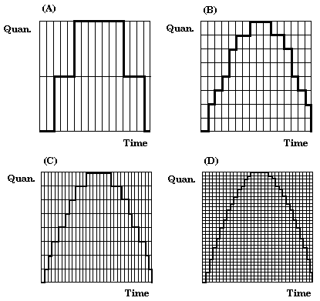
Digital Images - Quantisation

Slide 26
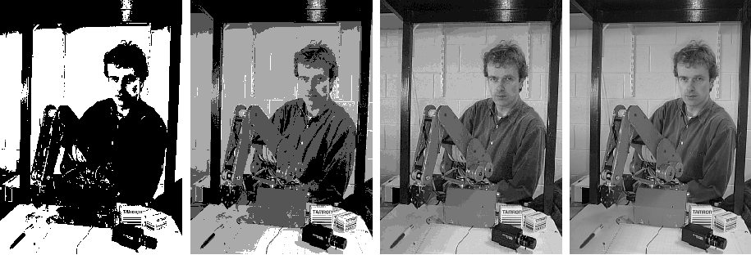
Digital Images - Quantisation
1 bit, 2 levels
2 bits, 4 levels
4 bits, 16 levels
8 bits, 256 levels

Slide 27
Digital Images - Resolution
It should be obvious what the numbers that make up the image actually mean
They are samples of the original light intensity waveform so therefore each one represents a discrete light intensity value
If the sampling rate is a whole multiple of the line rate of the video signal then the samples will form a rectangular array
Each element of the array is called a picture element or “pixel” and is a sample of the scene intensity at some position (x,y) at some time t
When these array elements are placed close enough together the observer perceives a continuous image
The number of pixels in 2-d array is known as the image resolution

Slide 28
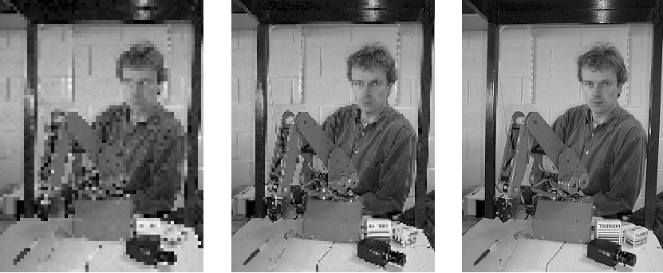
Digital Images - Resolution
Pixel
80 x 60
160 x 120
320 x 240

Slide 29
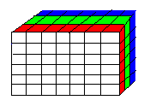
Digital Images - Colour
The notion of color in digital video or images is quite straightforward
Instead of each pixel in an image being a scalar representing light intensity of some scene point it is a 3D vector containing the amount of red, green and blue light intensities
We can think of color images as being 3-dimensional arrays
So a true color RGB image requires 24 bits per pixel
The color resolution of a 24 bit color image is 16,777,216
Digital video uses color difference values to reduce bandwidth

Slide 30
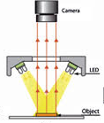
Lighting and Illumination
Light is of crucial importance in machine vision. The goal of lighting in machine vision is to obtain a robust application by:
Enhancing the features to be inspected.
Assuring high repeatability in image quality and appearance.
Illumination is the way an object is lit up and lighting is the actual lamp that generates the illumination.
Light can be ambient, such as normal indoor light or sunlight, or a special light that has been chosen with the particular vision application's needs in mind.
Most machine vision applications are sensitive to lighting variations!

Slide 31
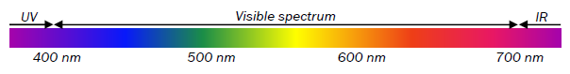
Illumination Principles
Light can be described as waves with three properties:
1. Wavelength or color, measured in nm (nanometers)
2. Intensity
3. Polarization.
Different wavelengths correspond to different colors. The human eye can see colors in the visible spectrum, whose colors range from violet to red. Light with shorter wavelength than violet is called UV (ultraviolet) and longer wavelength than red is called IR (infrared).

Slide 32
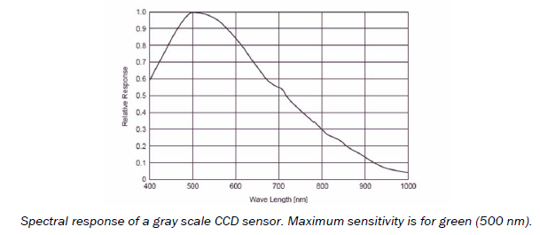
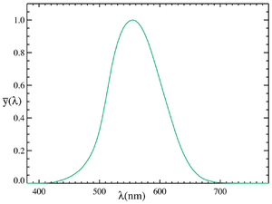
Image Sensor Spectral Response
Human eye

Slide 33
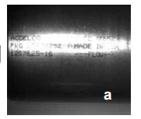
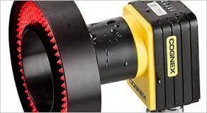
Lighting Types – Ring Light
A ring light is mounted around the optical axis of the lens, either on the camera or somewhere in between the camera and the object.
The angle of incidence depends on the ring diameter, where the lighting is mounted, and at what angle the LEDs are aimed.
The ring light is easy to use and mount as it normally goes around the camera or lens, can be high intensity but can cause hotspots in the resulting image due to direct or specular reflections

Slide 34
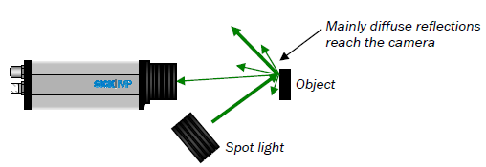
Lighting Types – Spot Light
A spot light has all the light emanating from one direction that is different from the optical axis.
For flat objects, only diffuse reflections reach the camera.
Prevents Hotspots, but might require an intense light source as it relies on diffuse reflections. Illumination will also not be even over object (2 spotlights will help this).

Slide 35
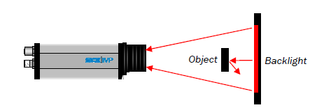
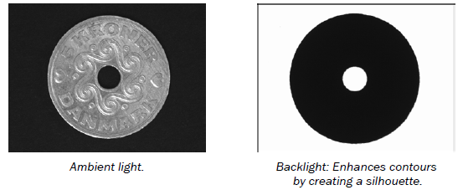
Lighting Types – Back Light
The backlight principle has the object being illuminated from behind to produce a contour or silhouette. Typically, the backlight is mounted perpendicularly to the optical axis.
This give very good contrast and is robust to object texture and ambient light but the back light needs to be bigger than the object

Slide 36
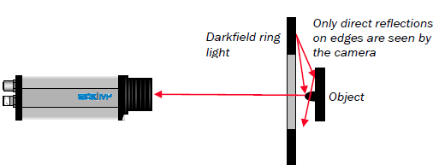
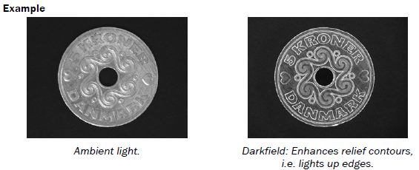
Lighting Types – Dark Field
Darkfield means that the object is illuminated at a large angle of incidence. Direct reflections only occur where there are edges.
Light that falls on flat surfaces is reflected away from the camera.
Good enhancement of scratches, protruding edges, and dirt on surfaces. Works on flat surfaces with small features that are close to camera

Slide 37
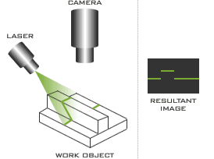
Lighting Types – Structured Light
Structured light is the process of projecting a known pattern (often grids or horizontal bars) on to a scene. The way that these deform when striking surfaces allows vision systems to calculate the depth and surface information of the objects in the scene
Normally the light source will be a laser diode (although LEDs are becoming more common) with some kind of projection lens for the light.
As all the power is concentrated into a small area these lights can be very intense if desired but also have significant safety considerations

Slide 38
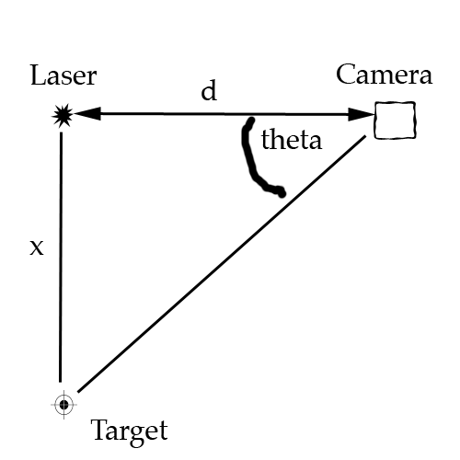
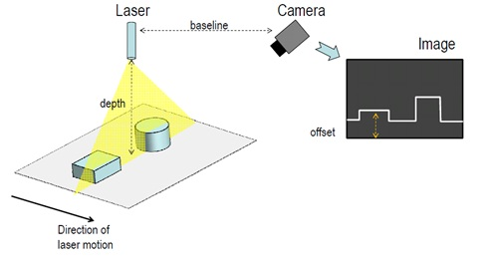
Lighting Types – Structured Light
The distance between the camera and laser diode, d, is fixed and known. The laser line is projected onto the sample and is monitored by the camera. Using the known parameters of the camera, the angle theta between the laser, camera, and laser line on the sample can be calculated. Upon computing this angle, the distance between the laser and the sample, x, can be determined using the formula x = d*tan(theta).

Slide 39
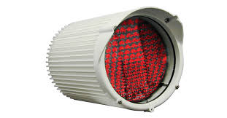
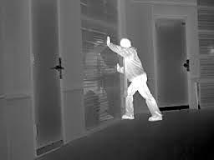
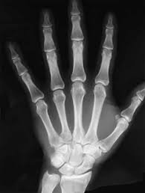
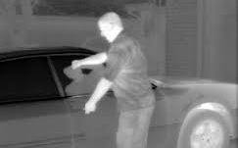
Non-Visible Radiation
Some sensors/devices are sensitive to radiation outside the visible spectrum (e.g. thermal imagery, near IR imagery, medical images (X-ray, CT, MRI etc).
Standard CCD sensors are typically sensitive to about 1000nm so can be used in the near infrared (NIR)
This arrangement will typically see an NIR light source and camera with a NIR optical filter on the lens that passes only NIR light.
NIR systems are used extensively in security applications at night because the NIR light is invisible to humans (also used in the Kinect)

Slide 40
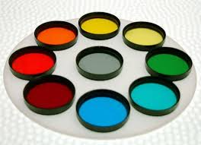
Optical Filters
An optical filter is a layer in front of the sensor or lens that absorbs certain wavelengths (colours) or polarizations. For example, sunglasses have an optical filter to protect your eyes from hazardous UV radiation. Similarly, we can use a filter in front of the camera to keep the light we want to see and suppress the rest.
Two main optical filter types are used for machine vision:
1. Band-pass filter: Only transmits light of a certain colour, i.e. within a certain wavelength interval. For example, a red filter only lets red through.
2. Polarization filter: Only transmits light with a certain polarization. Light changes its polarization when it is reflected, which allows us to filter out unwanted reflections.
Very robust lighting conditions can be achieved by combining an appropriate choice of LED colour with an optical filter having the corresponding band-pass wavelength.

Slide 41

Something else to consider – inverse square law
The inverse square law describes how the intensity of a light source (assumed to be isotropic source) decreases over distance and is governed by the following equation:
Any vision system designer should be aware of this when choosing a lighting arrangement. Sources like lasers are not effected as much by this law

Slide 42

So, we end up with an image, what do we do next?

Slide 43
So, we end up with an image, what do we do next? Inspect, measure, analyse, enhance…
Take the image of the two bottle tops. We are looking to see if the rim has any imperfections (might cause leaks etc.)
We can see the discontinuities in the one on the right but how do we write some software to find this type of thing?
This is the computer vision element of the course that deals with these type of problems
In this case, the rim is bright and circular so we could perhaps use those cues to isolate it in the image.
The we might follow the rim from a starting point looking for the discontinuities

